Slide 2
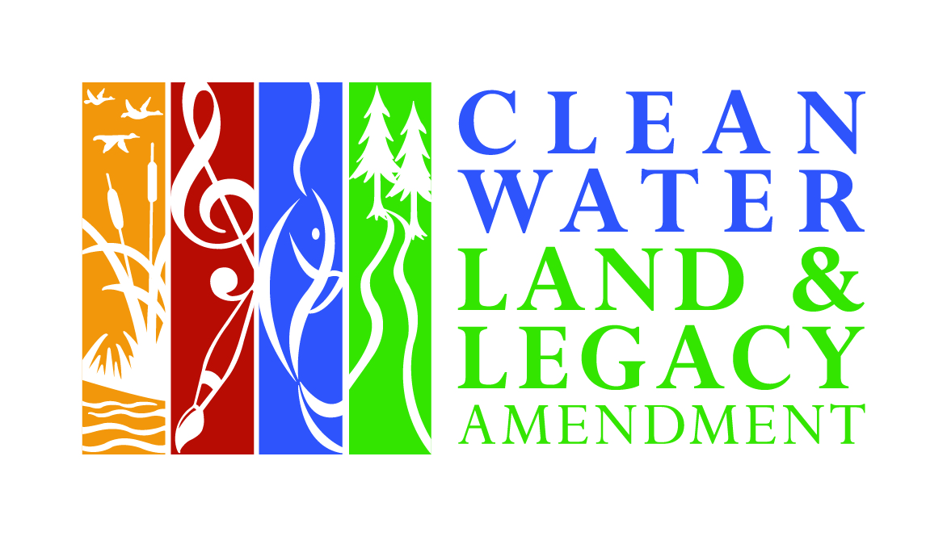
Legacy Fund Restoration Evaluations
Wade Johnson - MN DNR
Outdoor Heritage Council February, 14 2014

Slide 3
Legacy Fund Restoration Evaluations
Evaluation is Essential to “Hitting the Target”
Establish Effectiveness of Restorations
Facilitate Continuous Improvement
Restoration Effectiveness

Slide 4
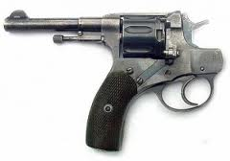
Evaluation Hitting the Target
PLAN
DO
(Achieving Project Goals)
READY
AIM
EVALUATE
EVALUATE
FIRE

Slide 5
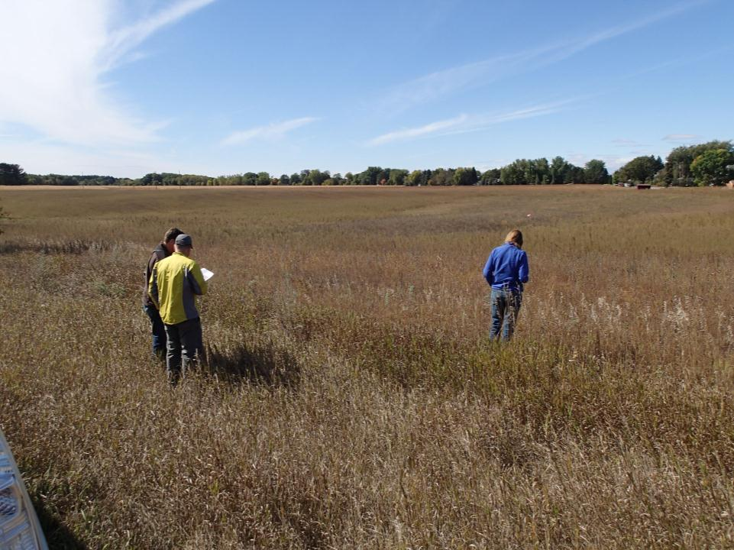
Notes:
Project evaluations are conducted throughout the State of Minnesota in a variety of habitat types, including wetlands, prairies, forests, rivers, streams and lakeshores.
Site assessment teams consisting of State Agency staff and private consultants with expertise in the habitat type being evaluated conduct primarily visual assessment of restoration progress.

Slide 6
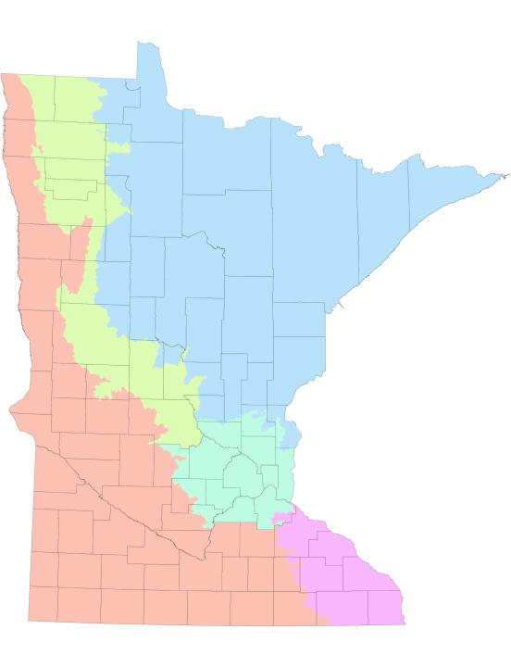
OHF Project Evaluations
Notes:
Selected Projects 2012

Slide 7
OHF Project Evaluations
FY 2012
Notes:
Selected Projects 2012

Slide 8
OHF Project Evaluations
FY 2012
FY 2013
Notes:
Selected Projects 2012

Slide 9
OHF Project Evaluations
FY 2012
FY 2013
FY 2014
part. 15
Notes:
Selected Projects 2012

Slide 10
Restoration Evaluation Panel
Chris Weir-Koetter DNR, Parks & Trails
Sue Galatowitsch U of M
Greg Berg Stearns Co. SWCD
Greg Hoch DNR, Wildlife
Greg Larson BWSR
Carol Strojny
Mark Oja MN NRCS

Slide 11
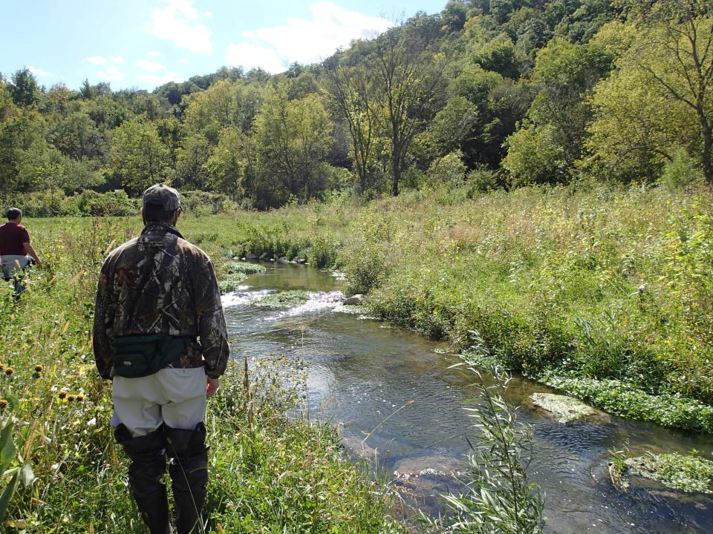
Establish Restoration Effectiveness
“Did project managers do what they said they would do?”

Slide 12
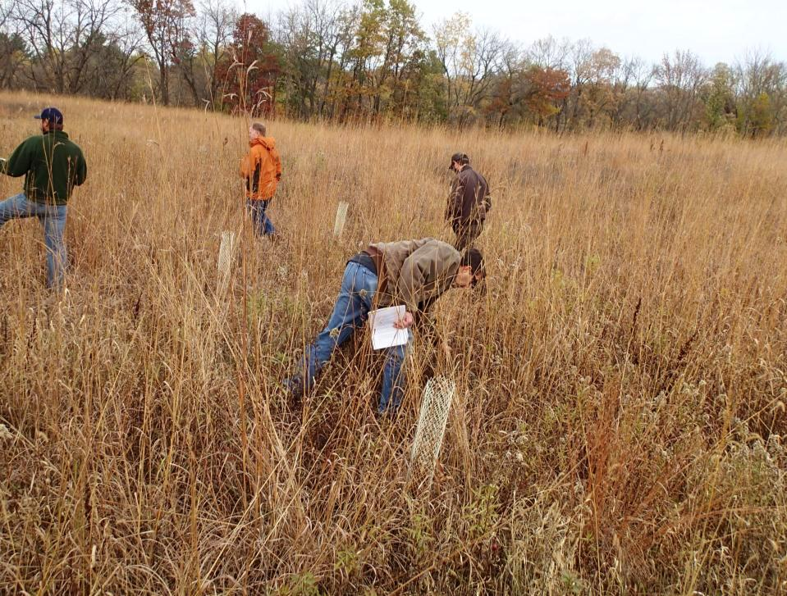
Establish Restoration Effectiveness
“Did project managers use commonly accepted guidelines and BMPs in project implementation?”

Slide 13
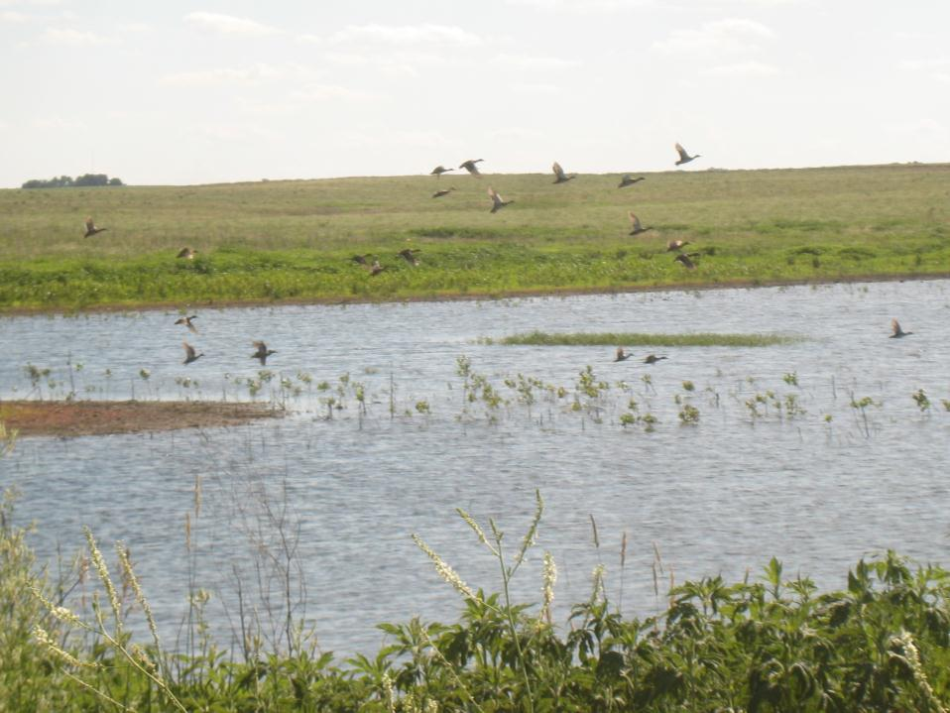
Establish Restoration Effectiveness
“Will the restoration actions be effective in meeting project goals?”

Slide 14
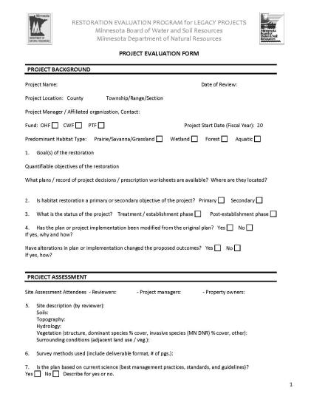
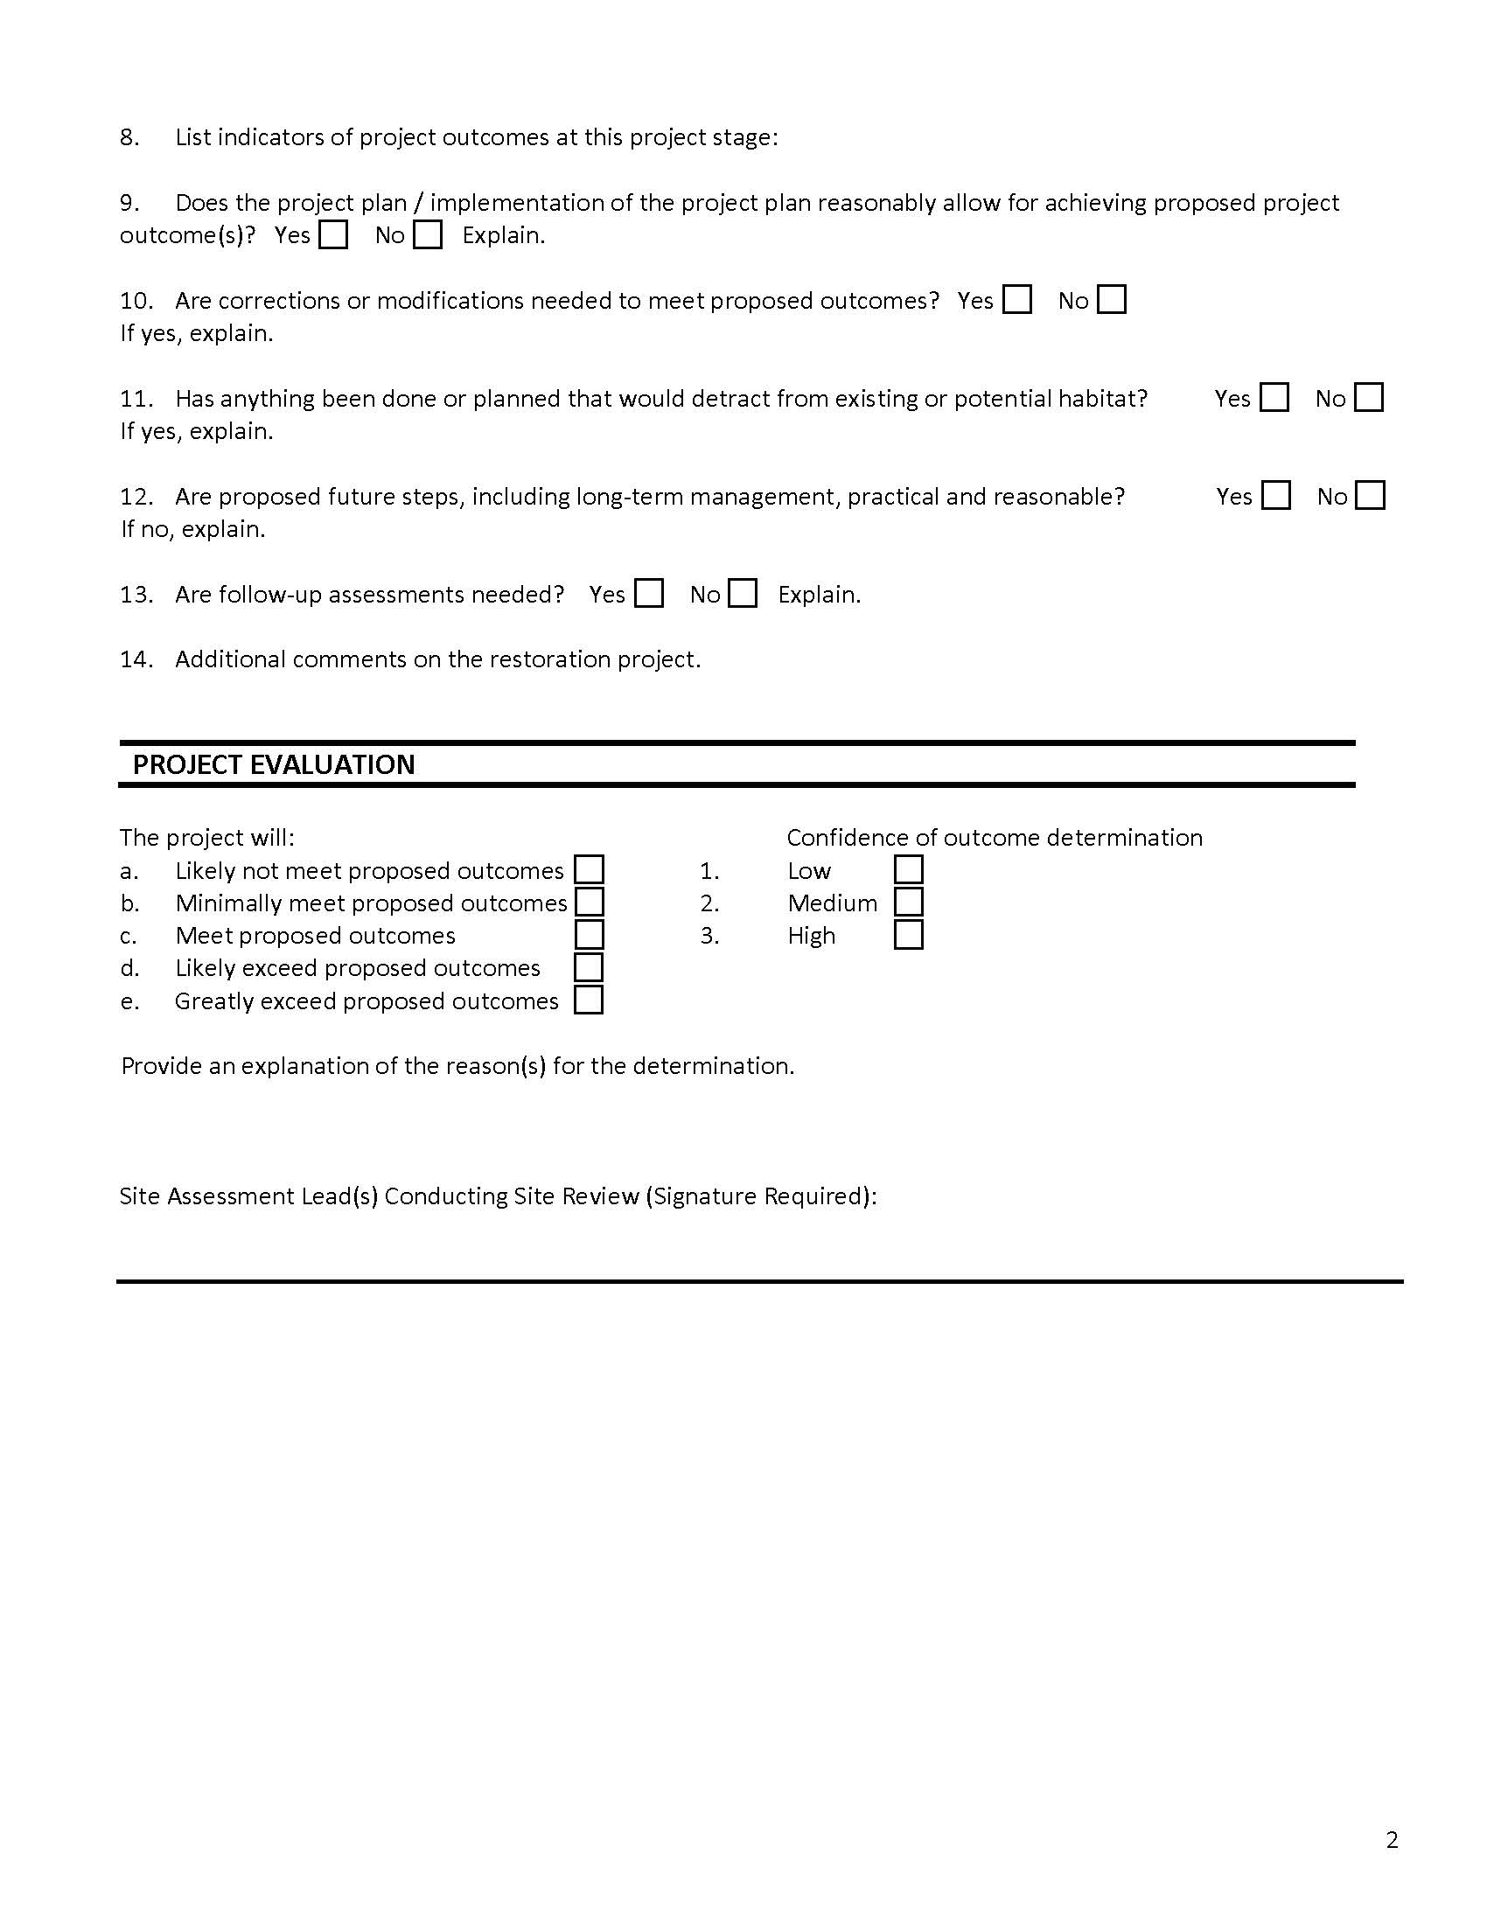
Standard Eval. Form
1. Goal(s) of the restoration:
Quantifiable objectives of the restoration:
6. Is the plan based on current science (best management
practices, standards, guidelines)? Describe:
7. List indicators of project outcomes at this project stage:
8. Does the project plan / implementation reasonably allow
for achieving proposed project outcome(s)? Explain:
9. Are corrections or modifications needed to meet
proposed outcomes? Explain:
Notes:
One requisite output from field evaluations is a standardized evaluation form; which probes vital questions regarding project success while remaining flexible enough to accommodate different project types.

Slide 15
Standard Eval Form
Notes:
And finally an assessment of the likelihood of the project meeting its proposed outcomes and the confidence level of this determination

Slide 16
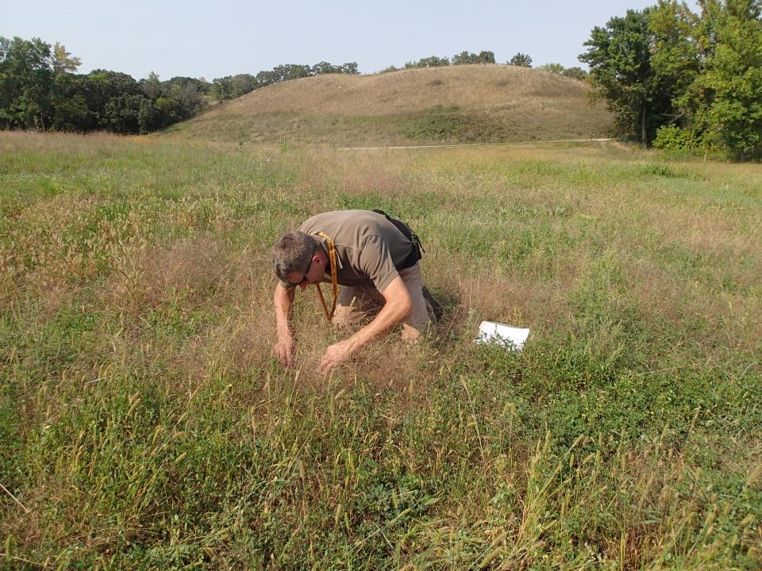
Getting into the Weeds

Slide 17
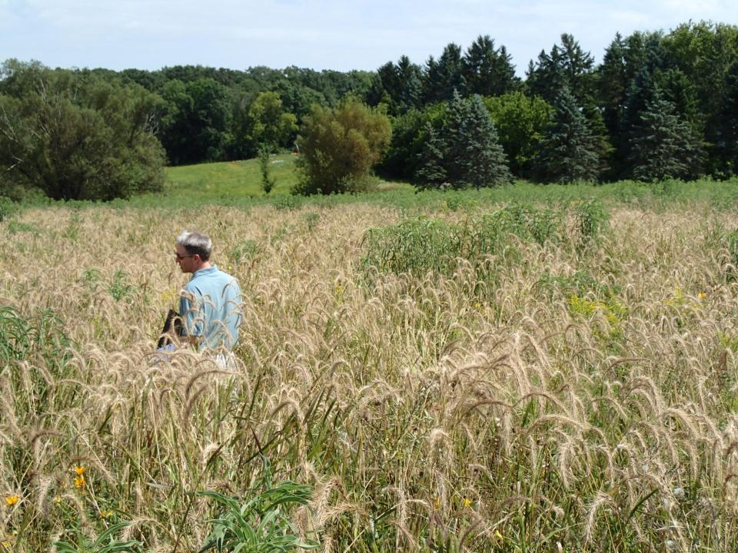
This seeding looks really successful…

Slide 18
This seeding looks really successful…

Slide 19
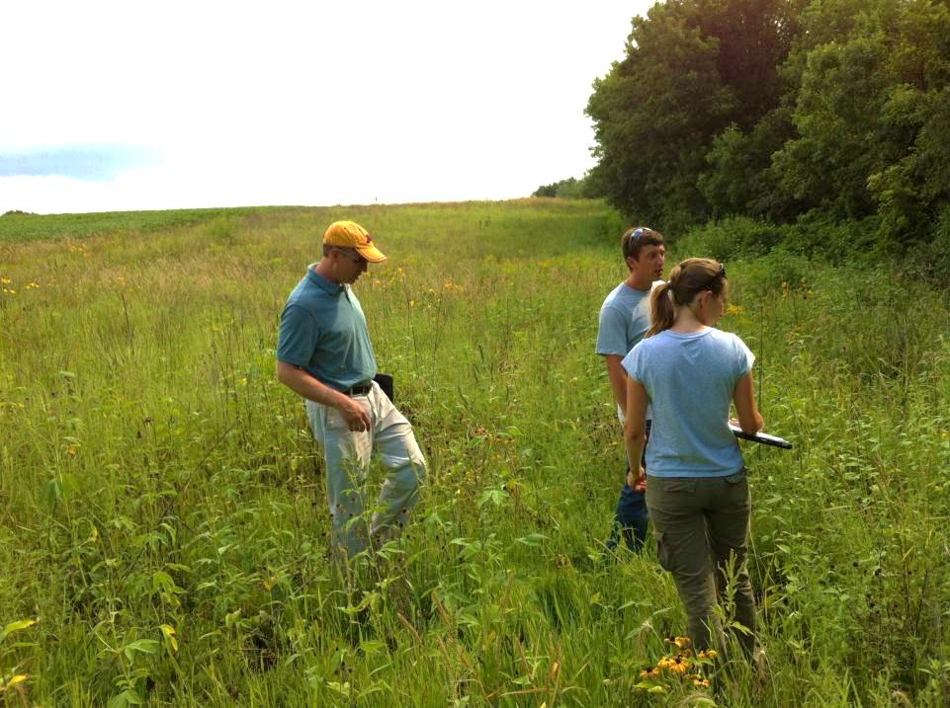
Here is what we found worked…
Here is a challenge we had…

Slide 20
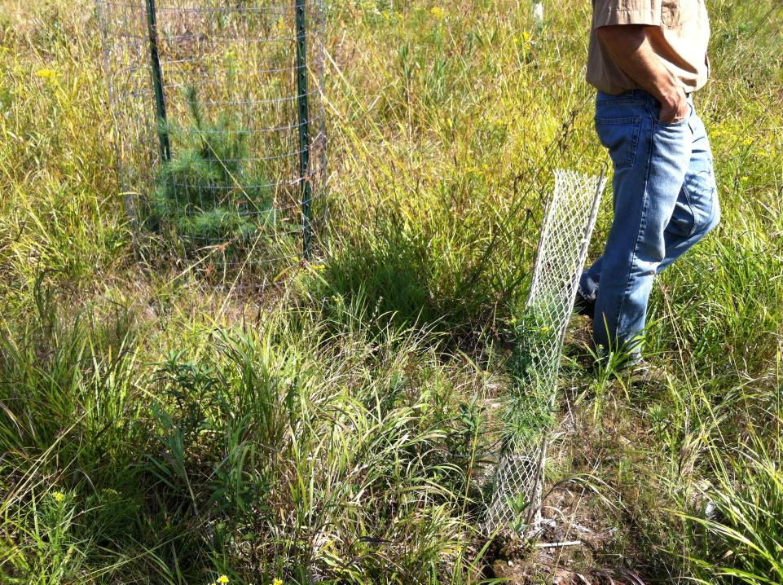
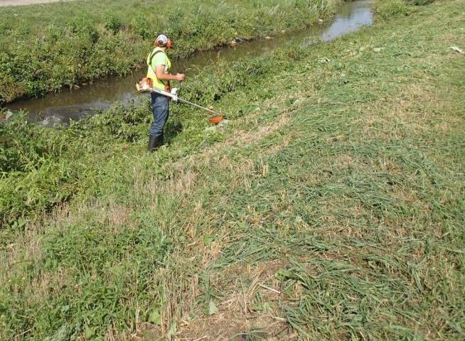
Facilitate Continuous Improvement
Feedback Lessons Learned

Slide 21
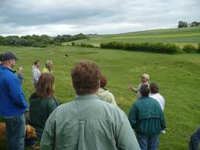
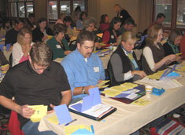
Facilitate Continuous Improvement
BWSR Academy
Disseminate Restoration Outcomes Support Technical Assistance Training

Slide 22
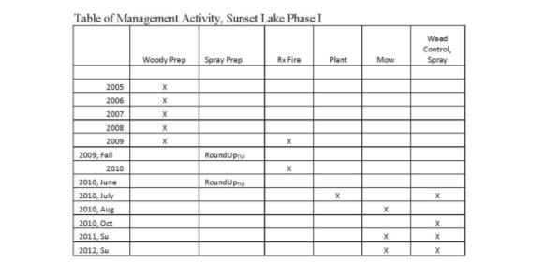
Facilitate Continuous Improvement
Project Data Templates / Examples Simple, Concise, USABLE
Promote Best Practices in Restoration Planning and Documentation

Slide 23
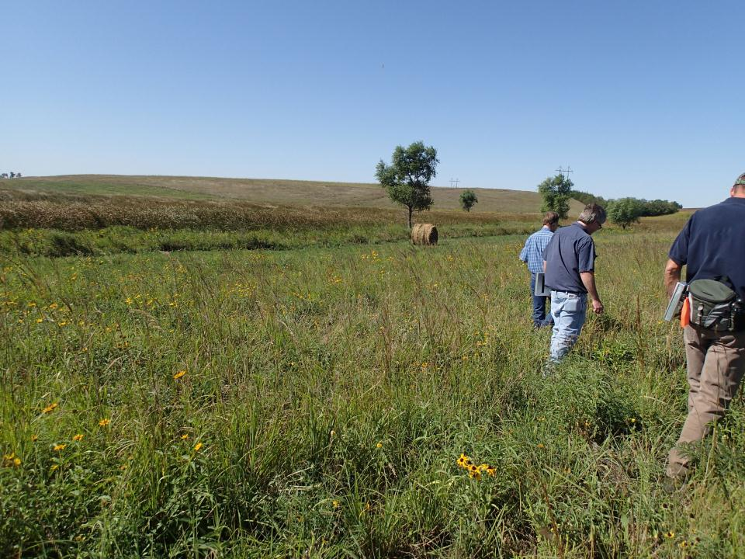
Tatley WMA, MN DNR

Slide 24
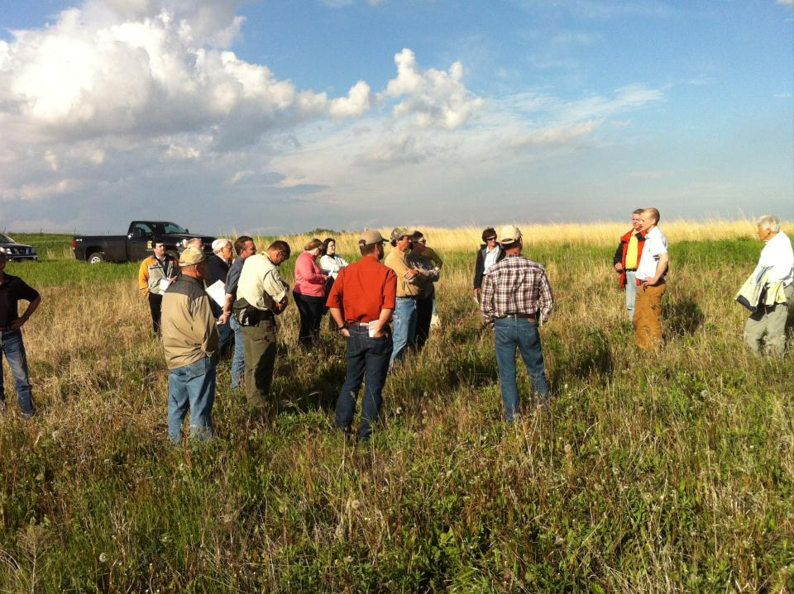
Tatley WMA, MN DNR

Slide 25
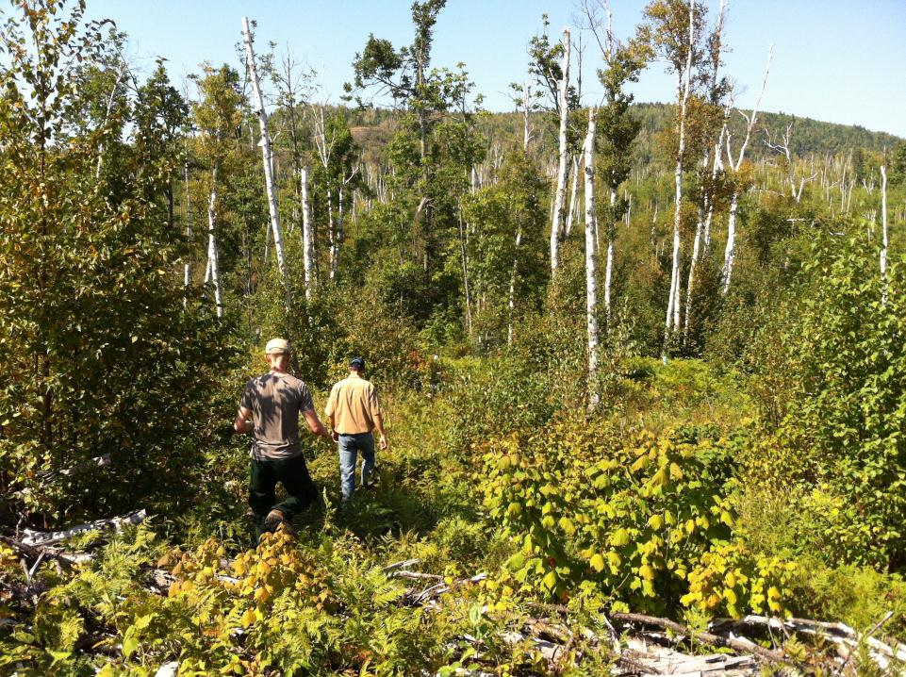
Tatley WMA, MN DNR
NE Forest, Conifer Regen - TNC

Slide 26
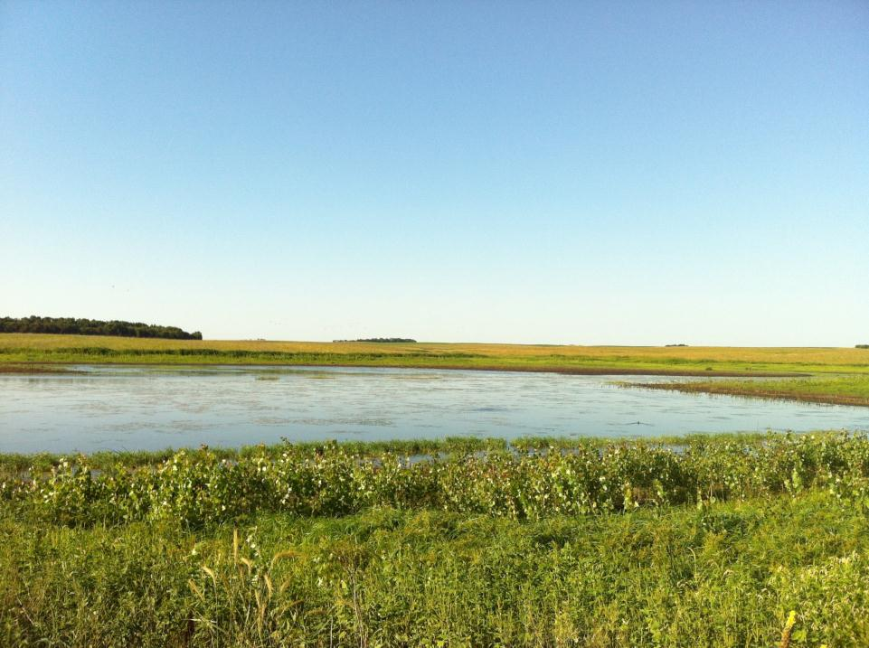
Lake Maria WMA,
MN Waterfowl Association

Slide 27
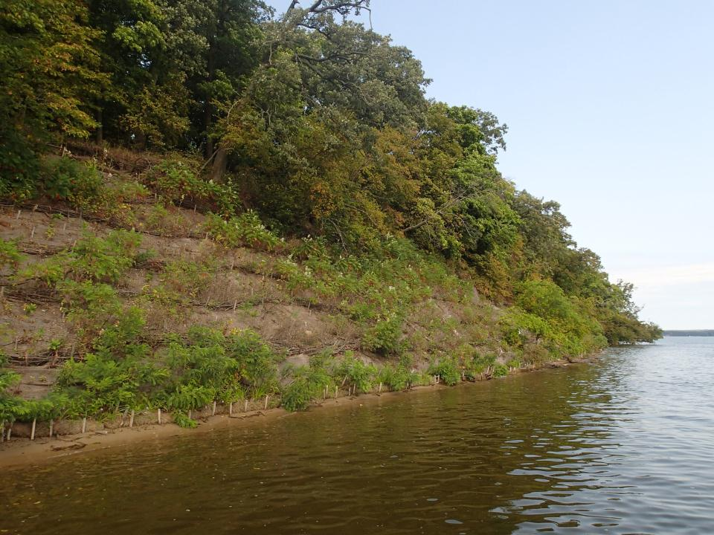
Rollie Johnson Island – CPL Grant

Slide 28
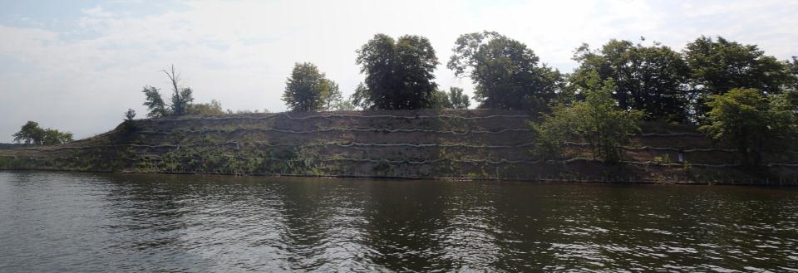
Rollie Johnson Island – CPL Grant

Slide 29
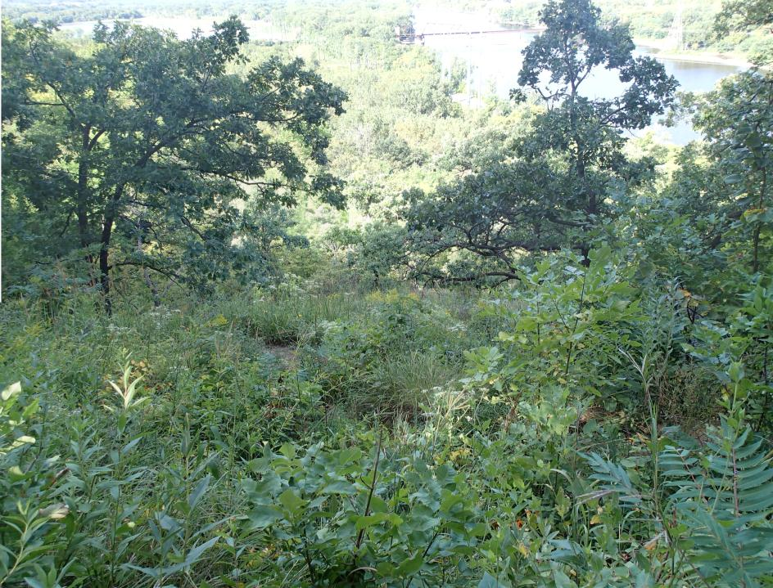
Metro Big Rivers (Great River Greening) – Cherokee Park

Slide 30
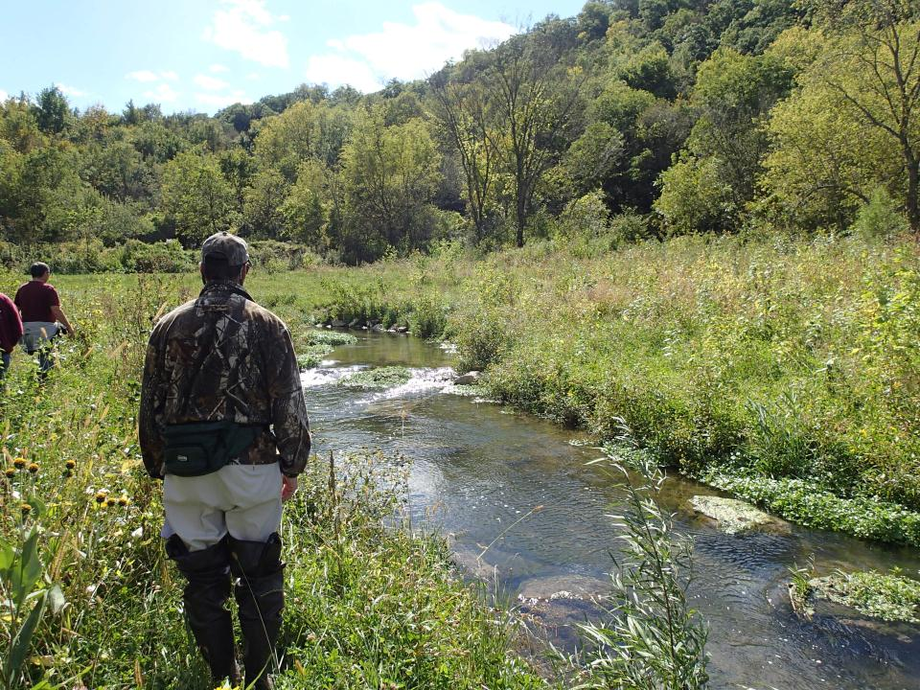
Trout Unlimited – W Indian Creek

Slide 31
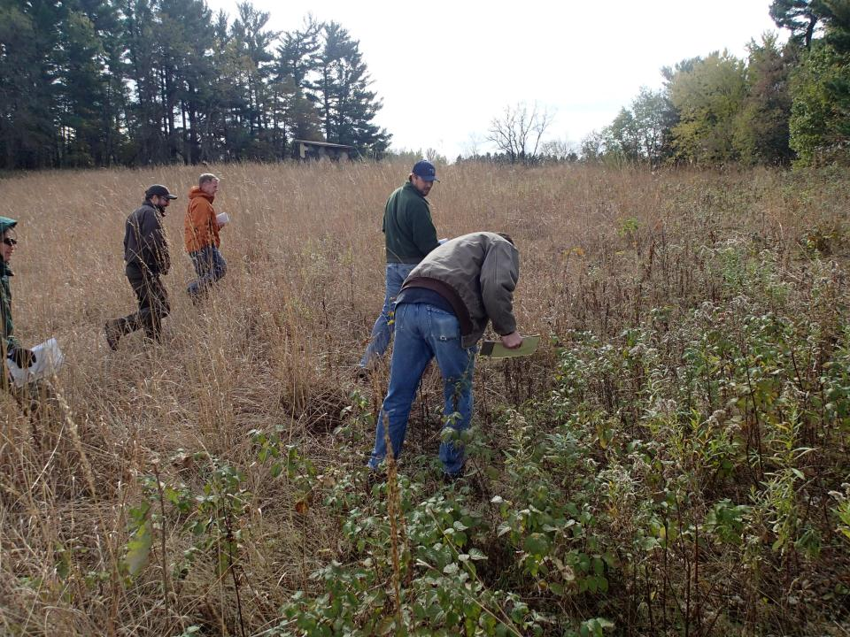
Anoka Sand Plain, Great River Greening – Beklin Homestead WMA

Slide 32
Shallow Lakes - Ducks Unlimited/MN DNR Fenmont WMA

Slide 33
Restoration Evaluations
Hit the Target
Effective Restorations
Continuous Improvement
Restoration Effectiveness

Slide 34
Thank You
Wade Johnson - Restoration Evaluation Coordinator, MN DNR
Wade.A.Johnson@state.mn.us 651 . 259 . 5075

Slide 35
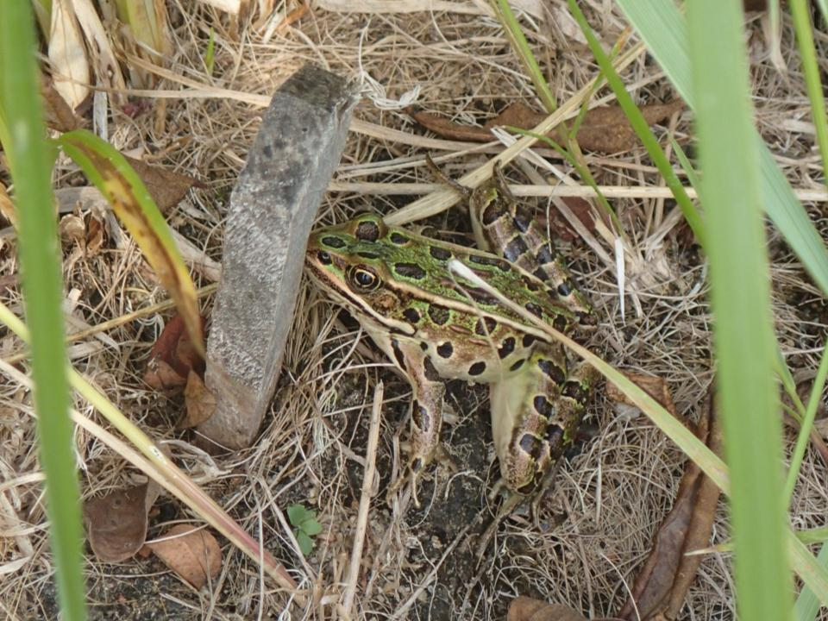
Legacy Fund Restoration Evaluations

